Slide 1


Slide 2
James 1:1
James, a servant of God and of the Lord Jesus Christ,
To the twelve tribes scattered among the nations:
Greetings.

Slide 3
James, the brother of Jesus, was the most prominent bishop of the early Jerusalem church and Jewish Christianity in the first generation of the church.
He wrote this encyclical letter to Jewish Christians to advise them on living a faithful Christian life. Unlike many of Paul’s writings, James is not concerned with relationships with Gentile Christians, so his language can sound very different than Paul’s.

Slide 4
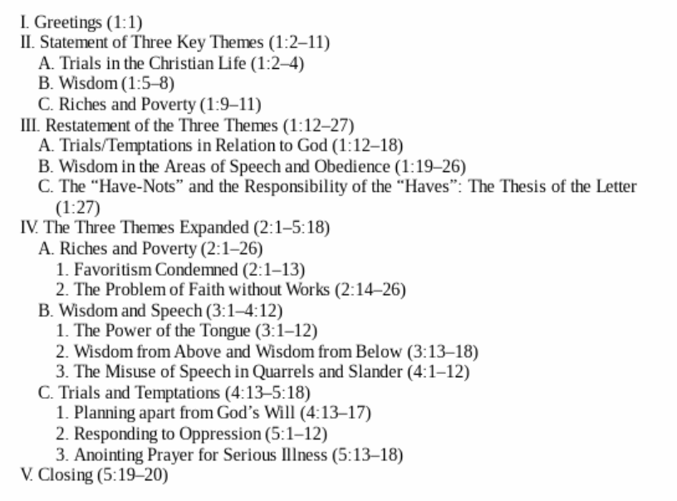

Slide 5
James 1
² Consider it pure joy, my brothers and sisters, whenever you face trials of many kinds, ³ because you know that the testing of your faith produces perseverance. ⁴ Let perseverance finish its work so that you may be mature and complete, not lacking anything. ⁵ If any of you lacks wisdom, you should ask God, who gives generously to all without finding fault, and it will be given to you. ⁶ But when you ask, you must believe and not doubt, because the one who doubts is like a wave of the sea, blown and tossed by the wind. ⁷ That person should not expect to receive anything from the Lord. ⁸ Such a person is double-minded and unstable in all they do.

Slide 6
James 1
² Consider it pure joy, my brothers and sisters, whenever you face trials of many kinds,

Slide 7
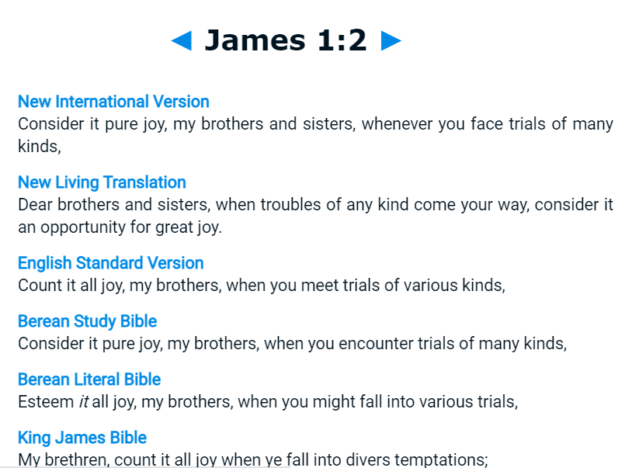

Slide 8
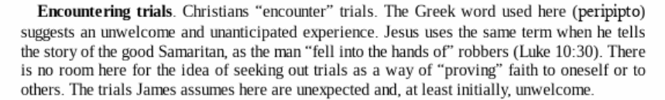
James 1
² Consider it pure joy, my brothers and sisters, whenever you face trials of many kinds,
David P. Nystrom, NIV Application Commentary: James.

Slide 9


Slide 10
James 1
² Consider it pure joy, my brothers and sisters, whenever you face trials of many kinds,
James is not telling us how to feel;
he is telling us how to think.

Slide 11
James 1
² Consider it pure joy, my brothers and sisters, whenever you face trials of many kinds,
James is not telling us how to feel;
he is telling us how to think.

Slide 12
James 1
² Consider it pure joy, my brothers and sisters, whenever you face trials of many kinds,

Slide 13
James 1
² Consider it pure joy, my brothers and sisters, whenever you face trials of many kinds,
Trials from God
Trials from Satan
Trials from our actions or the actions of others

Slide 14
James 1
² Consider it pure joy, my brothers and sisters, whenever you face trials of many kinds, ³ because you know that the testing of your faith produces perseverance. ⁴ Let perseverance finish its work so that you may be mature and complete, not lacking anything. ⁵ If any of you lacks wisdom, you should ask God, who gives generously to all without finding fault, and it will be given to you. ⁶ But when you ask, you must believe and not doubt, because the one who doubts is like a wave of the sea, blown and tossed by the wind. ⁷ That person should not expect to receive anything from the Lord. ⁸ Such a person is double-minded and unstable in all they do.

Slide 15
James 1
² Consider it pure joy, my brothers and sisters, whenever you face trials of many kinds, ³ because you know that the testing of your faith produces perseverance.

Slide 16
James 1
² Consider it pure joy, my brothers and sisters, whenever you face trials of many kinds, ³ because you know that the testing of your faith produces perseverance.

Slide 17
James 1
² Consider it pure joy, my brothers and sisters, whenever you face trials of many kinds, ³ because you know that the testing of your faith produces perseverance. ⁴ Let perseverance finish its work so that you may be mature and complete, not lacking anything.

Slide 18
James 1
² Consider it pure joy, my brothers and sisters, whenever you face trials of many kinds, ³ because you know that the testing of your faith produces perseverance. ⁴ Let perseverance finish its work so that you may be mature and complete, not lacking anything.
1:4 (NKJV) But let patience have its perfect work, that you may be perfect and complete, lacking nothing.

Slide 19
James 1
² Consider it pure joy, my brothers and sisters, whenever you face trials of many kinds, ³ because you know that the testing of your faith produces perseverance. ⁴ Let perseverance finish its work so that you may be mature and complete, not lacking anything.
1:4 (NKJV) But let patience have its perfect work, that you may be perfect and complete, lacking nothing.
Romans 5
³ Not only so, but we also glory in our sufferings, because we know that suffering produces perseverance; ⁴ perseverance, character; and character, hope. ⁵ And hope does not put us to shame, because God’s love has been poured out into our hearts through the Holy Spirit, who has been given to us.

Slide 20
James 1
² Consider it pure joy, my brothers and sisters, whenever you face trials of many kinds, ³ because you know that the testing of your faith produces perseverance. ⁴ Let perseverance finish its work so that you may be mature and complete, not lacking anything. ⁵ If any of you lacks wisdom, you should ask God, who gives generously to all without finding fault, and it will be given to you. ⁶ But when you ask, you must believe and not doubt, because the one who doubts is like a wave of the sea, blown and tossed by the wind. ⁷ That person should not expect to receive anything from the Lord. ⁸ Such a person is double-minded and unstable in all they do.

Slide 21
James 1
² Consider it pure joy, my brothers and sisters, whenever you face trials of many kinds, ³ because you know that the testing of your faith produces perseverance. ⁴ Let perseverance finish its work so that you may be mature and complete, not lacking anything. ⁵ If any of you lacks wisdom, you should ask God, who gives generously to all without finding fault, and it will be given to you.

Slide 22
Proverbs 9
¹⁰ The fear of the Lord is the beginning of wisdom, and knowledge of the Holy One is understanding. ¹¹ For through wisdom your days will be many, and years will be added to your life. ¹² If you are wise, your wisdom will reward you; if you are a mocker, you alone will suffer.

Slide 23
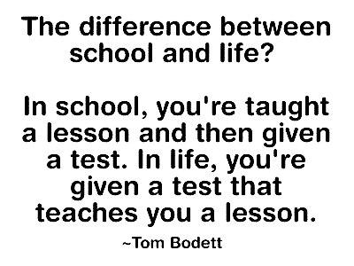

Slide 24
James 1
² Consider it pure joy, my brothers and sisters, whenever you face trials of many kinds, ³ because you know that the testing of your faith produces perseverance. ⁴ Let perseverance finish its work so that you may be mature and complete, not lacking anything. ⁵ If any of you lacks wisdom, you should ask God, who gives generously to all without finding fault, and it will be given to you.

Slide 25
James 1
² Consider it pure joy, my brothers and sisters, whenever you face trials of many kinds, ³ because you know that the testing of your faith produces perseverance. ⁴ Let perseverance finish its work so that you may be mature and complete, not lacking anything. ⁵ If any of you lacks wisdom, you should ask God, who gives generously to all without finding fault, and it will be given to you.
Matthew 7:9-11
⁹ “Which of you, if your son asks for bread, will give him a stone? ¹⁰ Or if he asks for a fish, will give him a snake? ¹¹ If you, then, though you are evil, know how to give good gifts to your children, how much more will your Father in heaven give good gifts to those who ask him!

Slide 26
James 1
² Consider it pure joy, my brothers and sisters, whenever you face trials of many kinds, ³ because you know that the testing of your faith produces perseverance. ⁴ Let perseverance finish its work so that you may be mature and complete, not lacking anything. ⁵ If any of you lacks wisdom, you should ask God, who gives generously to all without finding fault, and it will be given to you. ⁶ But when you ask, you must believe and not doubt, because the one who doubts is like a wave of the sea, blown and tossed by the wind. ⁷ That person should not expect to receive anything from the Lord. ⁸ Such a person is double-minded and unstable in all they do.

Slide 27
James 1
² Consider it pure joy, my brothers and sisters, whenever you face trials of many kinds, ³ because you know that the testing of your faith produces perseverance. ⁴ Let perseverance finish its work so that you may be mature and complete, not lacking anything. ⁵ If any of you lacks wisdom, you should ask God, who gives generously to all without finding fault, and it will be given to you. ⁶ But when you ask, you must believe and not doubt, because the one who doubts is like a wave of the sea, blown and tossed by the wind. ⁷ That person should not expect to receive anything from the Lord. ⁸ Such a person is double-minded and unstable in all they do.

Slide 28
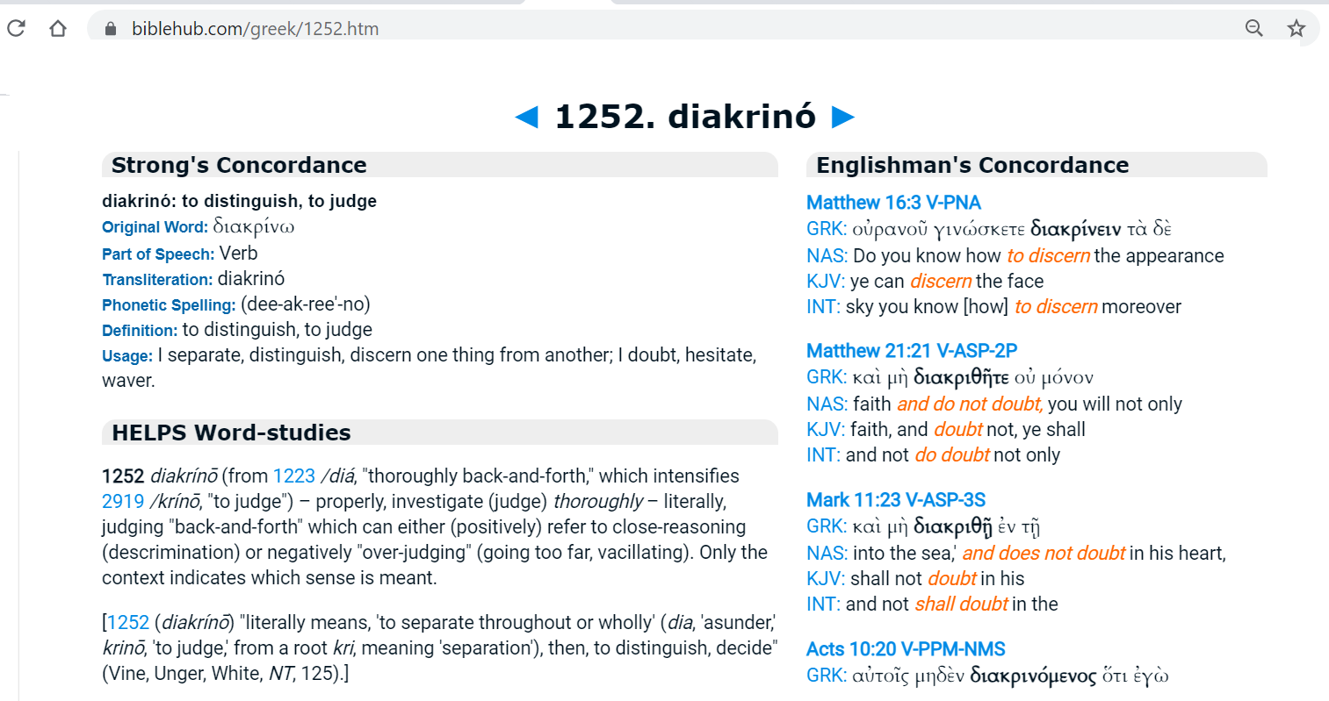

Slide 29
James 1
² Consider it pure joy, my brothers and sisters, whenever you face trials of many kinds, ³ because you know that the testing of your faith produces perseverance. ⁴ Let perseverance finish its work so that you may be mature and complete, not lacking anything. ⁵ If any of you lacks wisdom, you should ask God, who gives generously to all without finding fault, and it will be given to you. ⁶ But when you ask, you must believe and not doubt, because the one who doubts is like a wave of the sea, blown and tossed by the wind. ⁷ That person should not expect to receive anything from the Lord. ⁸ Such a person is double-minded and unstable in all they do.

Slide 30
“Cleanse your hands, you sinners, and purify your hearts, you double-minded“ (James 4:8)
Ah. So being double-minded is related to loving the world at the same time that you claim to love God. It’s related to hypocrisy.
For James, being double-minded or a “doubter” isn’t so much about having intellectual uncertainty; rather, it has to do with divided allegiance.
A double-minded person is insincere in their claim to trust God, because at the same time they’re wanting to hold on to their worldly resources. They’re keeping their options open. They say they have faith, but really they’re non-committal.
This also goes hand-in-hand with the word James uses for “doubt.” That may not actually be the best translation, since we tend to associate it today with having questions about something or with being uncertain about the future. But the Greek term James uses here (diakrino) has more to do with wavering between two options. In this context, then, it’s about someone wavering between trusting God and trusting themselves; relying on God or relying on worldly things.
Derek Demars

Slide 31
James 1
⁹ Believers in humble circumstances ought to take pride in their high position. ¹⁰ But the rich should take pride in their humiliation—since they will pass away like a wild flower. ¹¹ For the sun rises with scorching heat and withers the plant; its blossom falls and its beauty is destroyed. In the same way, the rich will fade away even while they go about their business.
¹² Blessed is the one who perseveres under trial because, having stood the test, that person will receive the crown of life that the Lord has promised to those who love him.

Slide 32


Slide 33
James 1
⁹ Believers in humble circumstances ought to take pride in their high position. ¹⁰ But the rich should take pride in their humiliation—since they will pass away like a wild flower. ¹¹ For the sun rises with scorching heat and withers the plant; its blossom falls and its beauty is destroyed. In the same way, the rich will fade away even while they go about their business.
¹² Blessed is the one who perseveres under trial because, having stood the test, that person will receive the crown of life that the Lord has promised to those who love him.

Slide 34
James 1
⁹ Believers in humble circumstances ought to take pride in their high position. ¹⁰ But the rich should take pride in their humiliation—since they will pass away like a wild flower. ¹¹ For the sun rises with scorching heat and withers the plant; its blossom falls and its beauty is destroyed. In the same way, the rich will fade away even while they go about their business.
¹² Blessed is the one who perseveres under trial because, having stood the test, that person will receive the crown of life that the Lord has promised to those who love him.

Slide 35
James 1
⁹ Believers in humble circumstances ought to take pride in their high position. ¹⁰ But the rich should take pride in their humiliation—since they will pass away like a wild flower. ¹¹ For the sun rises with scorching heat and withers the plant; its blossom falls and its beauty is destroyed. In the same way, the rich will fade away even while they go about their business.
¹² Blessed is the one who perseveres under trial because, having stood the test, that person will receive the crown of life that the Lord has promised to those who love him.

Slide 36
James 1
⁹ Believers in humble circumstances ought to take pride in their high position. ¹⁰ But the rich should take pride in their humiliation—since they will pass away like a wild flower. ¹¹ For the sun rises with scorching heat and withers the plant; its blossom falls and its beauty is destroyed. In the same way, the rich will fade away even while they go about their business.
¹² Blessed is the one who perseveres under trial because, having stood the test, that person will receive the crown of life that the Lord has promised to those who love him.

Slide 37
