Slide 1


Slide 2
James, the brother of Jesus, was the most prominent bishop of the early Jerusalem church and Jewish Christianity in the first generation of the church.
He wrote this encyclical letter to Jewish Christians to advise them on living a faithful Christian life. Unlike many of Paul’s writings, James is not concerned with relationships with Gentile Christians, so his language can sound very different than Paul’s.

Slide 3
James 2
My brothers and sisters, believers in our glorious Lord Jesus Christ must not show favoritism. ² Suppose a man comes into your meeting wearing a gold ring and fine clothes, and a poor man in filthy old clothes also comes in. ³ If you show special attention to the man wearing fine clothes and say, “Here’s a good seat for you,” but say to the poor man, “You stand there” or “Sit on the floor by my feet,” ⁴ have you not discriminated among yourselves and become judges with evil thoughts?

Slide 4
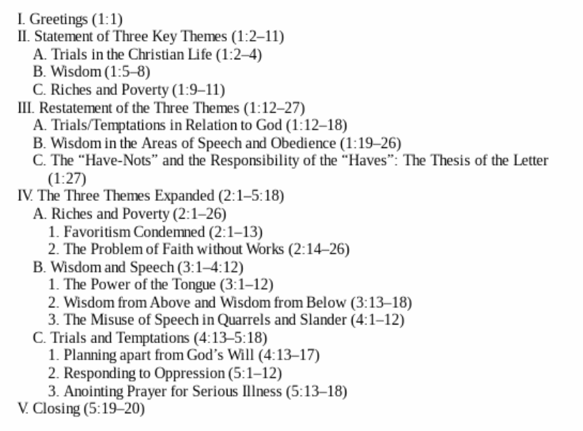

Slide 5
James 2:1
My brothers and sisters, believers in our glorious Lord Jesus Christ must not show favoritism.
KJV
My brethren, have not the faith of our Lord Jesus Christ, the Lord of glory, with respect of persons.
ASV
My brethren, hold not the faith of our Lord Jesus Christ, the Lord of glory, with respect of persons.

Slide 6
1 Corinthians 2:7-8
⁷ No, we declare God’s wisdom, a mystery that has been hidden and that God destined for our glory before time began. ⁸ None of the rulers of this age understood it, for if they had, they would not have crucified the Lord of glory.
1 Samuel 4:21-22
²¹ She named the boy Ichabod, saying, “The Glory has departed from Israel”—because of the capture of the ark of God and the deaths of her father-in-law and her husband. ²² She said, “The Glory has departed from Israel, for the ark of God has been captured.”

Slide 7
Psalm 24
⁷ Lift up your heads, you gates;
be lifted up, you ancient doors,
that the King of glory may come in.
⁸ Who is this King of glory?
The Lord strong and mighty,
the Lord mighty in battle.
⁹ Lift up your heads, you gates;
lift them up, you ancient doors,
that the King of glory may come in.
¹⁰ Who is he, this King of glory?
The Lord Almighty—
he is the King of glory.

Slide 8
James 2
My brothers and sisters, believers in our glorious Lord Jesus Christ must not show favoritism. ² Suppose a man comes into your meeting wearing a gold ring and fine clothes, and a poor man in filthy old clothes also comes in. ³ If you show special attention to the man wearing fine clothes and say, “Here’s a good seat for you,” but say to the poor man, “You stand there” or “Sit on the floor by my feet,” ⁴ have you not discriminated among yourselves and become judges with evil thoughts?

Slide 9
1 Corinthians 6
If any of you has a dispute with another, do you dare to take it before the ungodly for judgment instead of before the Lord’s people? ² Or do you not know that the Lord’s people will judge the world? And if you are to judge the world, are you not competent to judge trivial cases? ³ Do you not know that we will judge angels? How much more the things of this life! ⁴ Therefore, if you have disputes about such matters, do you ask for a ruling from those whose way of life is scorned in the church? ⁵ I say this to shame you. Is it possible that there is nobody among you wise enough to judge a dispute between believers? ⁶ But instead, one brother takes another to court—and this in front of unbelievers!

Slide 10
James 2
My brothers and sisters, believers in our glorious Lord Jesus Christ must not show favoritism. ² Suppose a man comes into your meeting wearing a gold ring and fine clothes, and a poor man in filthy old clothes also comes in. ³ If you show special attention to the man wearing fine clothes and say, “Here’s a good seat for you,” but say to the poor man, “You stand there” or “Sit on the floor by my feet,” ⁴ have you not discriminated among yourselves and become judges with evil thoughts?...
⁶ But you have dishonored the poor. Is it not the rich who are exploiting you? Are they not the ones who are dragging you into court?

Slide 11
James 2
⁵ Listen, my dear brothers and sisters: Has not God chosen those who are poor in the eyes of the world to be rich in faith and to inherit the kingdom he promised those who love him? ⁶ But you have dishonored the poor. Is it not the rich who are exploiting you? Are they not the ones who are dragging you into court? ⁷ Are they not the ones who are blaspheming the noble name of him to whom you belong?

Slide 12
James 1:10-11
But the rich should take pride in their humiliation—since they will pass away like a wild flower. For the sun rises with scorching heat and withers the plant; its blossom falls and its beauty is destroyed. In the same way, the rich will fade away even while they go about their business.
James 5
Now listen, you rich people, weep and wail because of the misery that is coming on you. ² Your wealth has rotted, and moths have eaten your clothes. ³ Your gold and silver are corroded. Their corrosion will testify against you and eat your flesh like fire. You have hoarded wealth in the last days.

Slide 13
Matthew 5
¹⁹ “Do not store up for yourselves treasures on earth, where moths and vermin destroy, and where thieves break in and steal. ²⁰ But store up for yourselves treasures in heaven, where moths and vermin do not destroy, and where thieves do not break in and steal. ²¹ For where your treasure is, there your heart will be also…
²⁴ “No one can serve two masters. Either you will hate the one and love the other, or you will be devoted to the one and despise the other. You cannot serve both God and money.
²⁵ “Therefore I tell you, do not worry about your life, what you will eat or drink; or about your body, what you will wear.

Slide 14
Luke 6
²⁰ Looking at his disciples, he said:
“Blessed are you who are poor,
for yours is the kingdom of God.
²¹ Blessed are you who hunger now,
for you will be satisfied.
Blessed are you who weep now,
for you will laugh.
²² Blessed are you when people hate you,
when they exclude you and insult you
and reject your name as evil,
because of the Son of Man.
²³ “Rejoice in that day and leap for joy, because great is your reward in heaven. For that is how their ancestors treated the prophets.

Slide 15
Poor men seek meat for their Stomach; rich Men Stomach for their Meat.
— Dr. Thomas Fuller, 1654-1734,

Slide 16
James 2
⁵ Listen, my dear brothers and sisters: Has not God chosen those who are poor in the eyes of the world to be rich in faith and to inherit the kingdom he promised those who love him? ⁶ But you have dishonored the poor. Is it not the rich who are exploiting you? Are they not the ones who are dragging you into court? ⁷ Are they not the ones who are blaspheming the noble name of him to whom you belong?

Slide 17
James 2
⁵ Listen, my dear brothers and sisters: Has not God chosen those who are poor in the eyes of the world to be rich in faith and to inherit the kingdom he promised those who love him? ⁶ But you have dishonored the poor. Is it not the rich who are exploiting you? Are they not the ones who are dragging you into court? ⁷ Are they not the ones who are blaspheming the noble name of him to whom you belong?

Slide 18
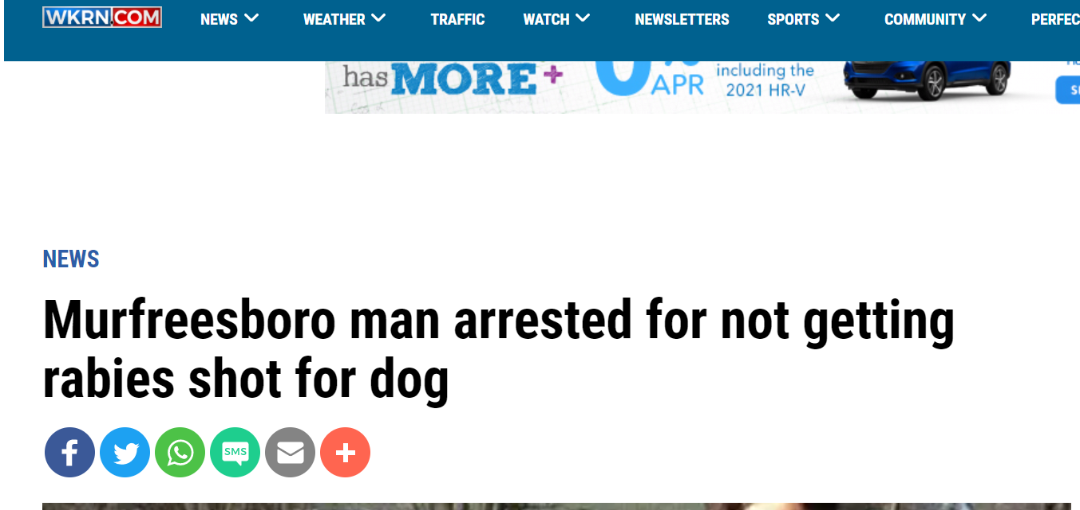

Slide 19
James 2
⁸ If you really keep the royal law found in Scripture, “Love your neighbor as yourself,” you are doing right. ⁹ But if you show favoritism, you sin and are convicted by the law as lawbreakers. ¹⁰ For whoever keeps the whole law and yet stumbles at just one point is guilty of breaking all of it. ¹¹ For he who said, “You shall not commit adultery,” also said, “You shall not murder.” If you do not commit adultery but do commit murder, you have become a lawbreaker.
¹² Speak and act as those who are going to be judged by the law that gives freedom, ¹³ because judgment without mercy will be shown to anyone who has not been merciful. Mercy triumphs over judgment.

Slide 20
James 2
⁸ If you really keep the royal law found in Scripture, “Love your neighbor as yourself,” you are doing right. ⁹ But if you show favoritism, you sin and are convicted by the law as lawbreakers. ¹⁰ For whoever keeps the whole law and yet stumbles at just one point is guilty of breaking all of it. ¹¹ For he who said, “You shall not commit adultery,” also said, “You shall not murder.” If you do not commit adultery but do commit murder, you have become a lawbreaker.
¹² Speak and act as those who are going to be judged by the law that gives freedom, ¹³ because judgment without mercy will be shown to anyone who has not been merciful. Mercy triumphs over judgment.

Slide 21
Matthew 22
³⁴ Hearing that Jesus had silenced the Sadducees, the Pharisees got together. ³⁵ One of them, an expert in the law, tested him with this question: ³⁶ “Teacher, which is the greatest commandment in the Law?”
³⁷ Jesus replied: “‘Love the Lord your God with all your heart and with all your soul and with all your mind.’ ³⁸ This is the first and greatest commandment. ³⁹ And the second is like it: ‘Love your neighbor as yourself.’ ⁴⁰ All the Law and the Prophets hang on these two commandments.”

Slide 22
James 2
⁸ If you really keep the royal law found in Scripture, “Love your neighbor as yourself,” you are doing right. ⁹ But if you show favoritism, you sin and are convicted by the law as lawbreakers. ¹⁰ For whoever keeps the whole law and yet stumbles at just one point is guilty of breaking all of it. ¹¹ For he who said, “You shall not commit adultery,” also said, “You shall not murder.” If you do not commit adultery but do commit murder, you have become a lawbreaker.
¹² Speak and act as those who are going to be judged by the law that gives freedom, ¹³ because judgment without mercy will be shown to anyone who has not been merciful. Mercy triumphs over judgment.

Slide 23
James 2
⁸ If you really keep the royal law found in Scripture, “Love your neighbor as yourself,” you are doing right. ⁹ But if you show favoritism, you sin and are convicted by the law as lawbreakers. ¹⁰ For whoever keeps the whole law and yet stumbles at just one point is guilty of breaking all of it. ¹¹ For he who said, “You shall not commit adultery,” also said, “You shall not murder.” If you do not commit adultery but do commit murder, you have become a lawbreaker.
¹² Speak and act as those who are going to be judged by the law that gives freedom, ¹³ because judgment without mercy will be shown to anyone who has not been merciful. Mercy triumphs over judgment.

Slide 24
Galatians 5
¹³ You, my brothers and sisters, were called to be free. But do not use your freedom to indulge the flesh; rather, serve one another humbly in love. ¹⁴ For the entire law is fulfilled in keeping this one command: “Love your neighbor as yourself.” ¹⁵ If you bite and devour each other, watch out or you will be destroyed by each other.

Slide 25
James 2
¹⁴ What good is it, my brothers and sisters, if someone claims to have faith but has no deeds? Can such faith save them? ¹⁵ Suppose a brother or a sister is without clothes and daily food. ¹⁶ If one of you says to them, “Go in peace; keep warm and well fed,” but does nothing about their physical needs, what good is it? ¹⁷ In the same way, faith by itself, if it is not accompanied by action, is dead.

Slide 26
James 2
¹⁸ But someone will say, “You have faith; I have deeds.”
Show me your faith without deeds, and I will show you my faith by my deeds. ¹⁹ You believe that there is one God. Good! Even the demons believe that—and shudder.
²⁰ You foolish person, do you want evidence that faith without deeds is useless? ²¹ Was not our father Abraham considered righteous for what he did when he offered his son Isaac on the altar? ²² You see that his faith and his actions were working together, and his faith was made complete by what he did. ²³ And the scripture was fulfilled that says, “Abraham believed God, and it was credited to him as righteousness,” and he was called God’s friend. ²⁴ You see that a person is considered righteous by what they do and not by faith alone.
²⁵ In the same way, was not even Rahab the prostitute considered righteous for what she did when she gave lodging to the spies and sent them off in a different direction? ²⁶ As the body without the spirit is dead, so faith without deeds is dead.

Slide 27
James 2
¹⁸ But someone will say, “You have faith; I have deeds.”
Show me your faith without deeds, and I will show you my faith by my deeds. ¹⁹ You believe that there is one God. Good! Even the demons believe that—and shudder.
²⁰ You foolish person, do you want evidence that faith without deeds is useless? ²¹ Was not our father Abraham considered righteous for what he did when he offered his son Isaac on the altar? ²² You see that his faith and his actions were working together, and his faith was made complete by what he did. ²³ And the scripture was fulfilled that says, “Abraham believed God, and it was credited to him as righteousness,” and he was called God’s friend. ²⁴ You see that a person is considered righteous by what they do and not by faith alone.
²⁵ In the same way, was not even Rahab the prostitute considered righteous for what she did when she gave lodging to the spies and sent them off in a different direction? ²⁶ As the body without the spirit is dead, so faith without deeds is dead.

Slide 28
Deuteronomy 6:4
⁴ Hear, O Israel: The Lord our God, the Lord is one.

Slide 29
Mark 1
²³ Just then a man in their synagogue who was possessed by an impure spirit cried out, ²⁴ “What do you want with us, Jesus of Nazareth? Have you come to destroy us? I know who you are—the Holy One of God!”

Slide 30
James 2
¹⁸ But someone will say, “You have faith; I have deeds.”
Show me your faith without deeds, and I will show you my faith by my deeds. ¹⁹ You believe that there is one God. Good! Even the demons believe that—and shudder.
²⁰ You foolish person, do you want evidence that faith without deeds is useless? ²¹ Was not our father Abraham considered righteous for what he did when he offered his son Isaac on the altar? ²² You see that his faith and his actions were working together, and his faith was made complete by what he did. ²³ And the scripture was fulfilled that says, “Abraham believed God, and it was credited to him as righteousness,” and he was called God’s friend. ²⁴ You see that a person is considered righteous by what they do and not by faith alone.
²⁵ In the same way, was not even Rahab the prostitute considered righteous for what she did when she gave lodging to the spies and sent them off in a different direction? ²⁶ As the body without the spirit is dead, so faith without deeds is dead.

Slide 31
Romans 4
What then shall we say that Abraham, our forefather according to the flesh, discovered in this matter? ² If, in fact, Abraham was justified by works, he had something to boast about—but not before God. ³ What does Scripture say? “Abraham believed God, and it was credited to him as righteousness.”
⁹ Is this blessedness only for the circumcised, or also for the uncircumcised? We have been saying that Abraham’s faith was credited to him as righteousness. ¹⁰ Under what circumstances was it credited? Was it after he was circumcised, or before? It was not after, but before! ¹¹ And he received circumcision as a sign, a seal of the righteousness that he had by faith while he was still uncircumcised. So then, he is the father of all who believe but have not been circumcised, in order that righteousness might be credited to them. ¹² And he is then also the father of the circumcised who not only are circumcised but who also follow in the footsteps of the faith that our father Abraham had before he was circumcised.
¹³ It was not through the law that Abraham and his offspring received the promise that he would be heir of the world, but through the righteousness that comes by faith. ¹⁴ For if those who depend on the law are heirs, faith means nothing and the promise is worthless, ¹⁵ because the law brings wrath. And where there is no law there is no transgression.
¹⁶ Therefore, the promise comes by faith, so that it may be by grace and may be guaranteed to all Abraham’s offspring—not only to those who are of the law but also to those who have the faith of Abraham. He is the father of us all. ¹⁷ As it is written: “I have made you a father of many nations.” He is our father in the sight of God, in whom he believed—the God who gives life to the dead and calls into being things that were not.

Slide 32
Romans 4
¹⁶ Therefore, the promise comes by faith, so that it may be by grace and may be guaranteed to all Abraham’s offspring—not only to those who are of the law but also to those who have the faith of Abraham. He is the father of us all. ¹⁷ As it is written: “I have made you a father of many nations.” He is our father in the sight of God, in whom he believed—the God who gives life to the dead and calls into being things that were not.

