Slide 1


Slide 2
James, the brother of Jesus, was the most prominent bishop of the early Jerusalem church and Jewish Christianity in the first generation of the church.
He wrote this encyclical letter to Jewish Christians to advise them on living a faithful Christian life. Unlike many of Paul’s writings, James is not concerned with relationships with Gentile Christians, so his language can sound very different than Paul’s.

Slide 3
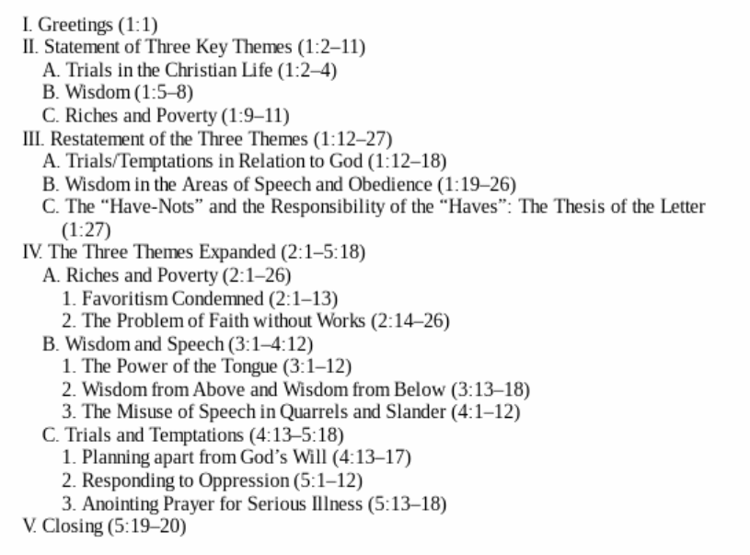

Slide 4
James 3
Not many of you should become teachers, my fellow believers, because you know that we who teach will be judged more strictly. ² We all stumble in many ways. Anyone who is never at fault in what they say is perfect, able to keep their whole body in check.

Slide 5
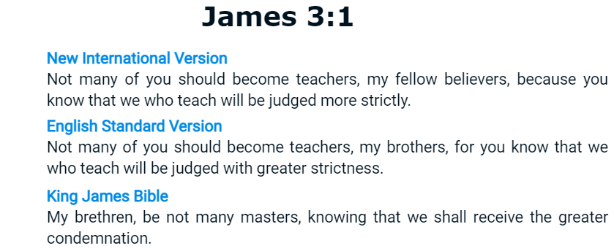

Slide 6
Philippians 1
¹⁵ It is true that some preach Christ out of envy and rivalry, but others out of goodwill. ¹⁶ The latter do so out of love, knowing that I am put here for the defense of the gospel. ¹⁷ The former preach Christ out of selfish ambition, not sincerely, supposing that they can stir up trouble for me while I am in chains. ¹⁸ But what does it matter? The important thing is that in every way, whether from false motives or true, Christ is preached. And because of this I rejoice.

Slide 7
James 3
Not many of you should become teachers, my fellow believers, because you know that we who teach will be judged more strictly. ² We all stumble in many ways. Anyone who is never at fault in what they say is perfect, able to keep their whole body in check.

Slide 8
James 3
Not many of you should become teachers, my fellow believers, because you know that we who teach will be judged more strictly. ² We all stumble in many ways. Anyone who is never at fault in what they say is perfect, able to keep their whole body in check.

Slide 9
James 3
Not many of you should become teachers, my fellow believers, because you know that we who teach will be judged more strictly. ² We all stumble in many ways. Anyone who is never at fault in what they say is perfect, able to keep their whole body in check.
James 3:2 (ESV)
² For we all stumble in many ways. And if anyone does not stumble in what he says, he is a perfect man, able also to bridle his whole body.

Slide 10
James 3
Not many of you should become teachers, my fellow believers, because you know that we who teach will be judged more strictly. ² We all stumble in many ways. Anyone who is never at fault in what they say is perfect, able to keep their whole body in check.
James 3:2 (ESV)
² For we all stumble in many ways. And if anyone does not stumble in what he says, he is a perfect man, able also to bridle his whole body.
James 1:26
If anyone thinks himself to be religious, yet does not bridle his tongue but deceives his own heart, this person’s religion is worthless.

Slide 11


Slide 12
James 3
³ When we put bits into the mouths of horses to make them obey us, we can turn the whole animal. ⁴ Or take ships as an example. Although they are so large and are driven by strong winds, they are steered by a very small rudder wherever the pilot wants to go. ⁵ Likewise, the tongue is a small part of the body, but it makes great boasts. Consider what a great forest is set on fire by a small spark. ⁶ The tongue also is a fire, a world of evil among the parts of the body. It corrupts the whole body, sets the whole course of one’s life on fire, and is itself set on fire by hell.
⁷ All kinds of animals, birds, reptiles and sea creatures are being tamed and have been tamed by mankind, ⁸ but no human being can tame the tongue. It is a restless evil, full of deadly poison.
⁹ With the tongue we praise our Lord and Father, and with it we curse human beings, who have been made in God’s likeness. ¹⁰ Out of the same mouth come praise and cursing. My brothers and sisters, this should not be. ¹¹ Can both fresh water and salt water flow from the same spring? ¹² My brothers and sisters, can a fig tree bear olives, or a grapevine bear figs? Neither can a salt spring produce fresh water.

Slide 13
James 3
³ When we put bits into the mouths of horses to make them obey us, we can turn the whole animal. ⁴ Or take ships as an example. Although they are so large and are driven by strong winds, they are steered by a very small rudder wherever the pilot wants to go. ⁵ Likewise, the tongue is a small part of the body, but it makes great boasts. Consider what a great forest is set on fire by a small spark. ⁶ The tongue also is a fire, a world of evil among the parts of the body. It corrupts the whole body, sets the whole course of one’s life on fire, and is itself set on fire by hell.
⁷ All kinds of animals, birds, reptiles and sea creatures are being tamed and have been tamed by mankind, ⁸ but no human being can tame the tongue. It is a restless evil, full of deadly poison.
⁹ With the tongue we praise our Lord and Father, and with it we curse human beings, who have been made in God’s likeness. ¹⁰ Out of the same mouth come praise and cursing. My brothers and sisters, this should not be. ¹¹ Can both fresh water and salt water flow from the same spring? ¹² My brothers and sisters, can a fig tree bear olives, or a grapevine bear figs? Neither can a salt spring produce fresh water.

Slide 14
James 3
³ When we put bits into the mouths of horses to make them obey us, we can turn the whole animal. ⁴ Or take ships as an example. Although they are so large and are driven by strong winds, they are steered by a very small rudder wherever the pilot wants to go. ⁵ Likewise, the tongue is a small part of the body, but it makes great boasts. Consider what a great forest is set on fire by a small spark. ⁶ The tongue also is a fire, a world of evil among the parts of the body. It corrupts the whole body, sets the whole course of one’s life on fire, and is itself set on fire by hell.
⁷ All kinds of animals, birds, reptiles and sea creatures are being tamed and have been tamed by mankind, ⁸ but no human being can tame the tongue. It is a restless evil, full of deadly poison.
⁹ With the tongue we praise our Lord and Father, and with it we curse human beings, who have been made in God’s likeness. ¹⁰ Out of the same mouth come praise and cursing. My brothers and sisters, this should not be. ¹¹ Can both fresh water and salt water flow from the same spring? ¹² My brothers and sisters, can a fig tree bear olives, or a grapevine bear figs? Neither can a salt spring produce fresh water.

Slide 15
James 3
³ When we put bits into the mouths of horses to make them obey us, we can turn the whole animal. ⁴ Or take ships as an example. Although they are so large and are driven by strong winds, they are steered by a very small rudder wherever the pilot wants to go. ⁵ Likewise, the tongue is a small part of the body, but it makes great boasts. Consider what a great forest is set on fire by a small spark. ⁶ The tongue also is a fire, a world of evil among the parts of the body. It corrupts the whole body, sets the whole course of one’s life on fire, and is itself set on fire by hell.
⁷ All kinds of animals, birds, reptiles and sea creatures are being tamed and have been tamed by mankind, ⁸ but no human being can tame the tongue. It is a restless evil, full of deadly poison.
⁹ With the tongue we praise our Lord and Father, and with it we curse human beings, who have been made in God’s likeness. ¹⁰ Out of the same mouth come praise and cursing. My brothers and sisters, this should not be. ¹¹ Can both fresh water and salt water flow from the same spring? ¹² My brothers and sisters, can a fig tree bear olives, or a grapevine bear figs? Neither can a salt spring produce fresh water.

Slide 16
James 3
³ When we put bits into the mouths of horses to make them obey us, we can turn the whole animal. ⁴ Or take ships as an example. Although they are so large and are driven by strong winds, they are steered by a very small rudder wherever the pilot wants to go. ⁵ Likewise, the tongue is a small part of the body, but it makes great boasts. Consider what a great forest is set on fire by a small spark. ⁶ The tongue also is a fire, a world of evil among the parts of the body. It corrupts the whole body, sets the whole course of one’s life on fire, and is itself set on fire by hell.
⁷ All kinds of animals, birds, reptiles and sea creatures are being tamed and have been tamed by mankind, ⁸ but no human being can tame the tongue. It is a restless evil, full of deadly poison.
⁹ With the tongue we praise our Lord and Father, and with it we curse human beings, who have been made in God’s likeness. ¹⁰ Out of the same mouth come praise and cursing. My brothers and sisters, this should not be. ¹¹ Can both fresh water and salt water flow from the same spring? ¹² My brothers and sisters, can a fig tree bear olives, or a grapevine bear figs? Neither can a salt spring produce fresh water.

Slide 17
James 3
³ When we put bits into the mouths of horses to make them obey us, we can turn the whole animal. ⁴ Or take ships as an example. Although they are so large and are driven by strong winds, they are steered by a very small rudder wherever the pilot wants to go. ⁵ Likewise, the tongue is a small part of the body, but it makes great boasts. Consider what a great forest is set on fire by a small spark. ⁶ The tongue also is a fire, a world of evil among the parts of the body. It corrupts the whole body, sets the whole course of one’s life on fire, and is itself set on fire by hell.
⁷ All kinds of animals, birds, reptiles and sea creatures are being tamed and have been tamed by mankind, ⁸ but no human being can tame the tongue. It is a restless evil, full of deadly poison.
⁹ With the tongue we praise our Lord and Father, and with it we curse human beings, who have been made in God’s likeness. ¹⁰ Out of the same mouth come praise and cursing. My brothers and sisters, this should not be. ¹¹ Can both fresh water and salt water flow from the same spring? ¹² My brothers and sisters, can a fig tree bear olives, or a grapevine bear figs? Neither can a salt spring produce fresh water.

Slide 18
James 3
³ When we put bits into the mouths of horses to make them obey us, we can turn the whole animal. ⁴ Or take ships as an example. Although they are so large and are driven by strong winds, they are steered by a very small rudder wherever the pilot wants to go. ⁵ Likewise, the tongue is a small part of the body, but it makes great boasts. Consider what a great forest is set on fire by a small spark. ⁶ The tongue also is a fire, a world of evil among the parts of the body. It corrupts the whole body, sets the whole course of one’s life on fire, and is itself set on fire by hell.
⁷ All kinds of animals, birds, reptiles and sea creatures are being tamed and have been tamed by mankind, ⁸ but no human being can tame the tongue. It is a restless evil, full of deadly poison.
⁹ With the tongue we praise our Lord and Father, and with it we curse human beings, who have been made in God’s likeness. ¹⁰ Out of the same mouth come praise and cursing. My brothers and sisters, this should not be. ¹¹ Can both fresh water and salt water flow from the same spring? ¹² My brothers and sisters, can a fig tree bear olives, or a grapevine bear figs? Neither can a salt spring produce fresh water.

Slide 19
Matthew 12
³³ “Make a tree good and its fruit will be good, or make a tree bad and its fruit will be bad, for a tree is recognized by its fruit. ³⁴ You brood of vipers, how can you who are evil say anything good? For the mouth speaks what the heart is full of. ³⁵ A good man brings good things out of the good stored up in him, and an evil man brings evil things out of the evil stored up in him. ³⁶ But I tell you that everyone will have to give account on the day of judgment for every empty word they have spoken. ³⁷ For by your words you will be acquitted, and by your words you will be condemned.”

Slide 20
James 3
³ When we put bits into the mouths of horses to make them obey us, we can turn the whole animal. ⁴ Or take ships as an example. Although they are so large and are driven by strong winds, they are steered by a very small rudder wherever the pilot wants to go. ⁵ Likewise, the tongue is a small part of the body, but it makes great boasts. Consider what a great forest is set on fire by a small spark. ⁶ The tongue also is a fire, a world of evil among the parts of the body. It corrupts the whole body, sets the whole course of one’s life on fire, and is itself set on fire by hell.
⁷ All kinds of animals, birds, reptiles and sea creatures are being tamed and have been tamed by mankind, ⁸ but no human being can tame the tongue. It is a restless evil, full of deadly poison.
⁹ With the tongue we praise our Lord and Father, and with it we curse human beings, who have been made in God’s likeness. ¹⁰ Out of the same mouth come praise and cursing. My brothers and sisters, this should not be. ¹¹ Can both fresh water and salt water flow from the same spring? ¹² My brothers and sisters, can a fig tree bear olives, or a grapevine bear figs? Neither can a salt spring produce fresh water.

Slide 21
James 3
³ When we put bits into the mouths of horses to make them obey us, we can turn the whole animal. ⁴ Or take ships as an example. Although they are so large and are driven by strong winds, they are steered by a very small rudder wherever the pilot wants to go. ⁵ Likewise, the tongue is a small part of the body, but it makes great boasts. Consider what a great forest is set on fire by a small spark. ⁶ The tongue also is a fire, a world of evil among the parts of the body. It corrupts the whole body, sets the whole course of one’s life on fire, and is itself set on fire by hell.
⁷ All kinds of animals, birds, reptiles and sea creatures are being tamed and have been tamed by mankind, ⁸ but no human being can tame the tongue. It is a restless evil, full of deadly poison.
⁹ With the tongue we praise our Lord and Father, and with it we curse human beings, who have been made in God’s likeness. ¹⁰ Out of the same mouth come praise and cursing. My brothers and sisters, this should not be. ¹¹ Can both fresh water and salt water flow from the same spring? ¹² My brothers and sisters, can a fig tree bear olives, or a grapevine bear figs? Neither can a salt spring produce fresh water.

Slide 22
James 3
³ When we put bits into the mouths of horses to make them obey us, we can turn the whole animal. ⁴ Or take ships as an example. Although they are so large and are driven by strong winds, they are steered by a very small rudder wherever the pilot wants to go. ⁵ Likewise, the tongue is a small part of the body, but it makes great boasts. Consider what a great forest is set on fire by a small spark. ⁶ The tongue also is a fire, a world of evil among the parts of the body. It corrupts the whole body, sets the whole course of one’s life on fire, and is itself set on fire by hell.
⁷ All kinds of animals, birds, reptiles and sea creatures are being tamed and have been tamed by mankind, ⁸ but no human being can tame the tongue. It is a restless evil, full of deadly poison.
⁹ With the tongue we praise our Lord and Father, and with it we curse human beings, who have been made in God’s likeness. ¹⁰ Out of the same mouth come praise and cursing. My brothers and sisters, this should not be. ¹¹ Can both fresh water and salt water flow from the same spring? ¹² My brothers and sisters, can a fig tree bear olives, or a grapevine bear figs? Neither can a salt spring produce fresh water.

Slide 23
James 3
³ When we put bits into the mouths of horses to make them obey us, we can turn the whole animal. ⁴ Or take ships as an example. Although they are so large and are driven by strong winds, they are steered by a very small rudder wherever the pilot wants to go. ⁵ Likewise, the tongue is a small part of the body, but it makes great boasts. Consider what a great forest is set on fire by a small spark. ⁶ The tongue also is a fire, a world of evil among the parts of the body. It corrupts the whole body, sets the whole course of one’s life on fire, and is itself set on fire by hell.
⁷ All kinds of animals, birds, reptiles and sea creatures are being tamed and have been tamed by mankind, ⁸ but no human being can tame the tongue. It is a restless evil, full of deadly poison.
⁹ With the tongue we praise our Lord and Father, and with it we curse human beings, who have been made in God’s likeness. ¹⁰ Out of the same mouth come praise and cursing. My brothers and sisters, this should not be. ¹¹ Can both fresh water and salt water flow from the same spring? ¹² My brothers and sisters, can a fig tree bear olives, or a grapevine bear figs? Neither can a salt spring produce fresh water.

Slide 24
James 3
³ When we put bits into the mouths of horses to make them obey us, we can turn the whole animal. ⁴ Or take ships as an example. Although they are so large and are driven by strong winds, they are steered by a very small rudder wherever the pilot wants to go. ⁵ Likewise, the tongue is a small part of the body, but it makes great boasts. Consider what a great forest is set on fire by a small spark. ⁶ The tongue also is a fire, a world of evil among the parts of the body. It corrupts the whole body, sets the whole course of one’s life on fire, and is itself set on fire by hell.
⁷ All kinds of animals, birds, reptiles and sea creatures are being tamed and have been tamed by mankind, ⁸ but no human being can tame the tongue. It is a restless evil, full of deadly poison.
⁹ With the tongue we praise our Lord and Father, and with it we curse human beings, who have been made in God’s likeness. ¹⁰ Out of the same mouth come praise and cursing. My brothers and sisters, this should not be. ¹¹ Can both fresh water and salt water flow from the same spring? ¹² My brothers and sisters, can a fig tree bear olives, or a grapevine bear figs? Neither can a salt spring produce fresh water.

Slide 25
James 3
³ When we put bits into the mouths of horses to make them obey us, we can turn the whole animal. ⁴ Or take ships as an example. Although they are so large and are driven by strong winds, they are steered by a very small rudder wherever the pilot wants to go. ⁵ Likewise, the tongue is a small part of the body, but it makes great boasts. Consider what a great forest is set on fire by a small spark. ⁶ The tongue also is a fire, a world of evil among the parts of the body. It corrupts the whole body, sets the whole course of one’s life on fire, and is itself set on fire by hell.
⁷ All kinds of animals, birds, reptiles and sea creatures are being tamed and have been tamed by mankind, ⁸ but no human being can tame the tongue. It is a restless evil, full of deadly poison.
⁹ With the tongue we praise our Lord and Father, and with it we curse human beings, who have been made in God’s likeness. ¹⁰ Out of the same mouth come praise and cursing. My brothers and sisters, this should not be. ¹¹ Can both fresh water and salt water flow from the same spring? ¹² My brothers and sisters, can a fig tree bear olives, or a grapevine bear figs? Neither can a salt spring produce fresh water.

Slide 26
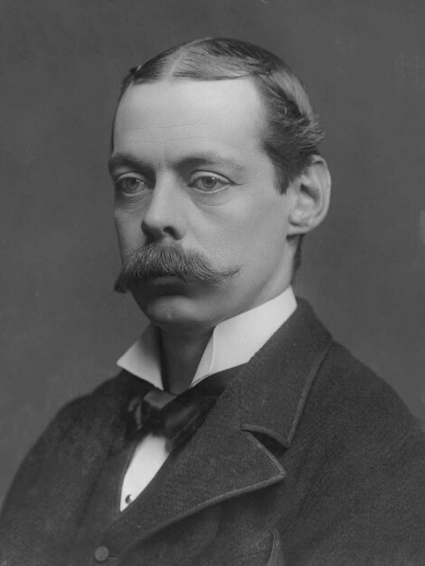
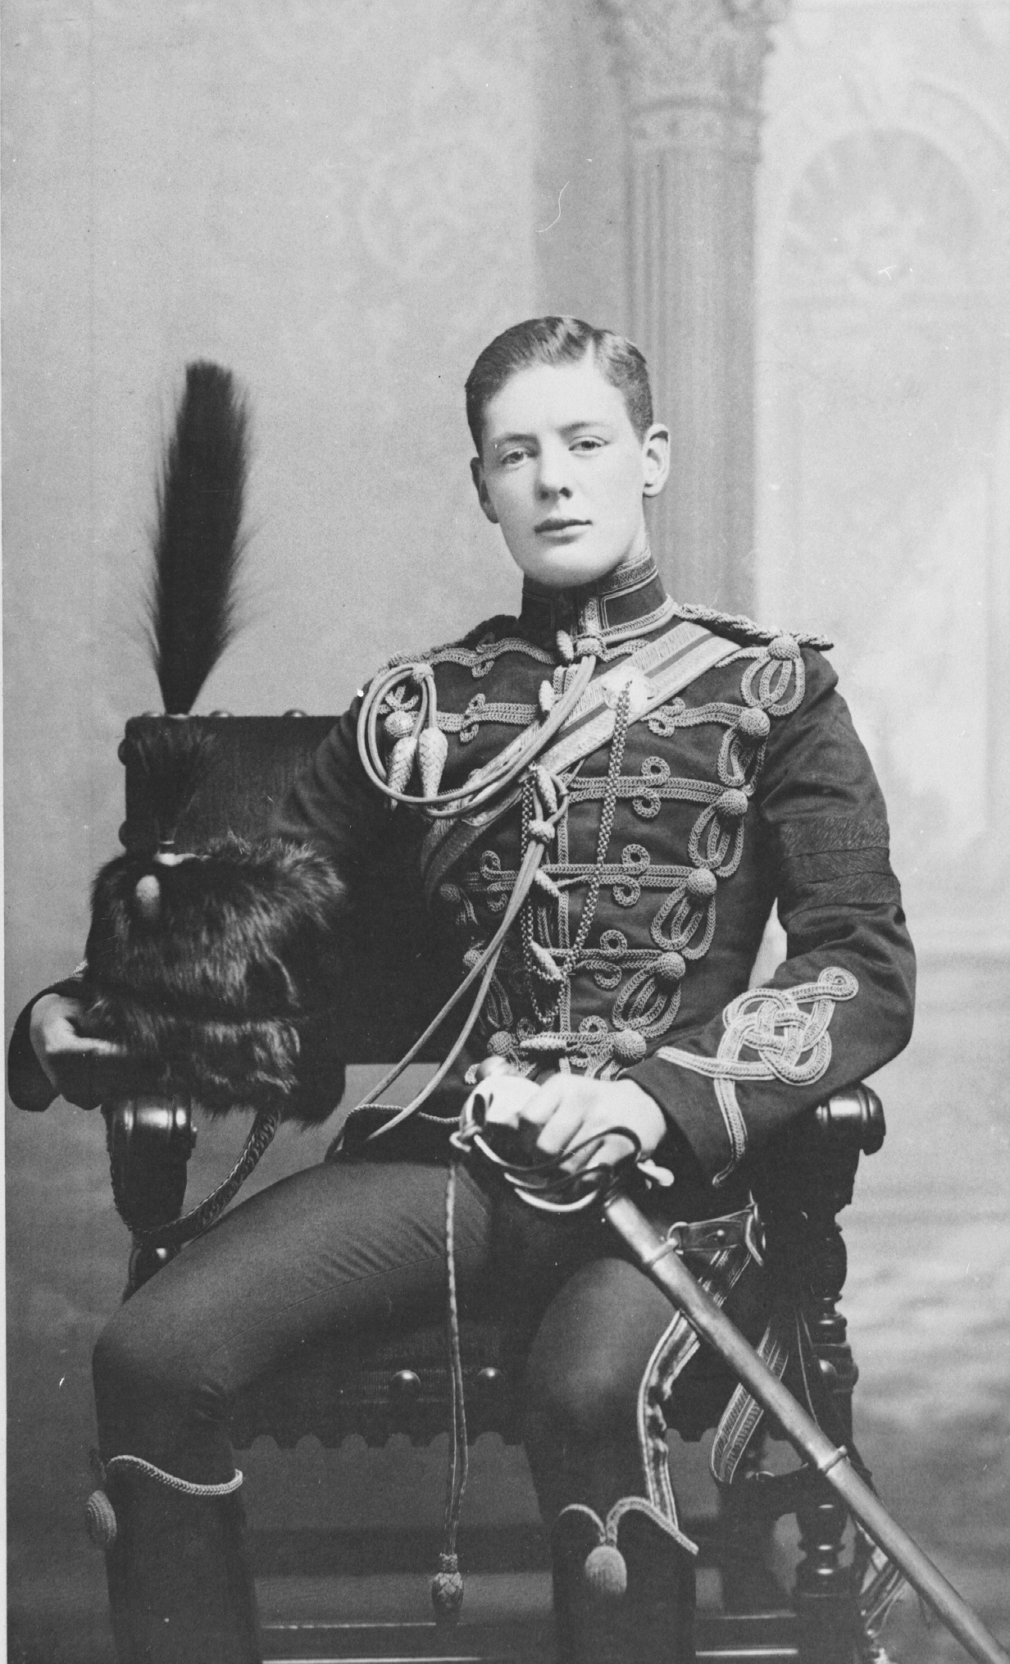
Lord Randolph Churchill
Winston Churchill

Slide 27
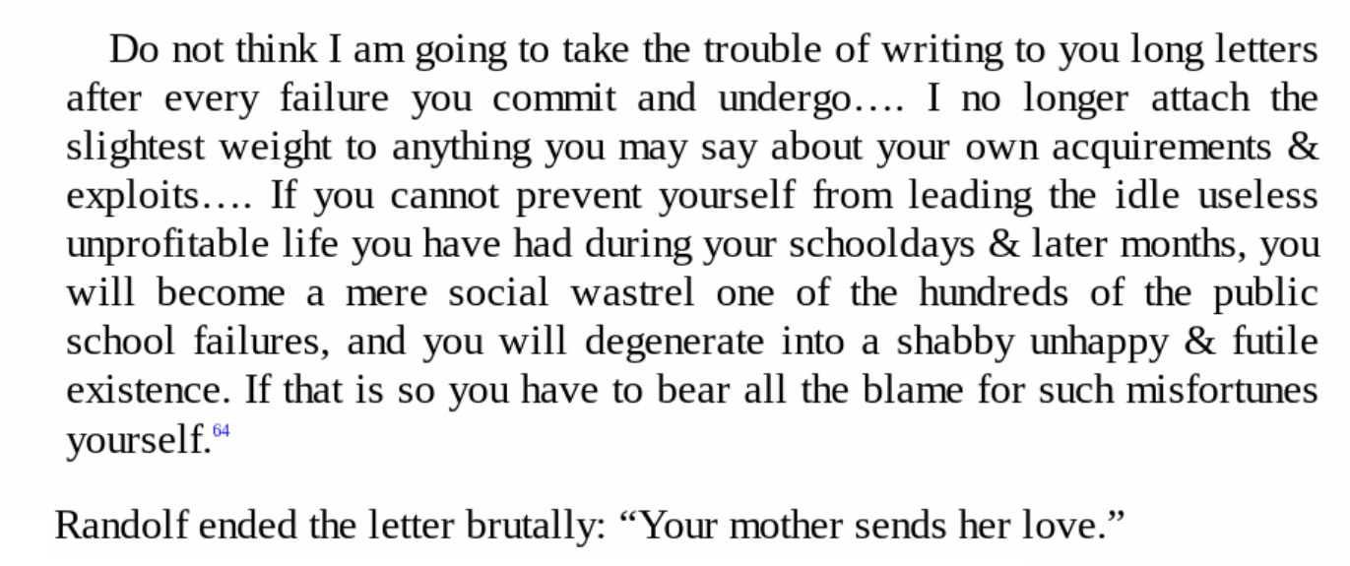
David P. Nystrom, The NIV Application Commentary: James (1997).

Slide 28
James 3
¹³ Who is wise and understanding among you? Let them show it by their good life, by deeds done in the humility that comes from wisdom. ¹⁴ But if you harbor bitter envy and selfish ambition in your hearts, do not boast about it or deny the truth. ¹⁵ Such “wisdom” does not come down from heaven but is earthly, unspiritual, demonic. ¹⁶ For where you have envy and selfish ambition, there you find disorder and every evil practice.
¹⁷ But the wisdom that comes from heaven is first of all pure; then peace-loving, considerate, submissive, full of mercy and good fruit, impartial and sincere. ¹⁸ Peacemakers who sow in peace reap a harvest of righteousness.

Slide 29
James 3
¹³ Who is wise and understanding among you? Let them show it by their good life, by deeds done in the humility that comes from wisdom. ¹⁴ But if you harbor bitter envy and selfish ambition in your hearts, do not boast about it or deny the truth. ¹⁵ Such “wisdom” does not come down from heaven but is earthly, unspiritual, demonic. ¹⁶ For where you have envy and selfish ambition, there you find disorder and every evil practice.
¹⁷ But the wisdom that comes from heaven is first of all pure; then peace-loving, considerate, submissive, full of mercy and good fruit, impartial and sincere. ¹⁸ Peacemakers who sow in peace reap a harvest of righteousness.

Slide 30
James 3
¹³ Who is wise and understanding among you? Let them show it by their good life, by deeds done in the humility that comes from wisdom. ¹⁴ But if you harbor bitter envy and selfish ambition in your hearts, do not boast about it or deny the truth. ¹⁵ Such “wisdom” does not come down from heaven but is earthly, unspiritual, demonic. ¹⁶ For where you have envy and selfish ambition, there you find disorder and every evil practice.
¹⁷ But the wisdom that comes from heaven is first of all pure; then peace-loving, considerate, submissive, full of mercy and good fruit, impartial and sincere. ¹⁸ Peacemakers who sow in peace reap a harvest of righteousness.

Slide 31
James 3
¹³ Who is wise and understanding among you? Let them show it by their good life, by deeds done in the humility that comes from wisdom. ¹⁴ But if you harbor bitter envy and selfish ambition in your hearts, do not boast about it or deny the truth. ¹⁵ Such “wisdom” does not come down from heaven but is earthly, unspiritual, demonic. ¹⁶ For where you have envy and selfish ambition, there you find disorder and every evil practice.
¹⁷ But the wisdom that comes from heaven is first of all pure; then peace-loving, considerate, submissive, full of mercy and good fruit, impartial and sincere. ¹⁸ Peacemakers who sow in peace reap a harvest of righteousness.

Slide 32
James 3
¹³ Who is wise and understanding among you? Let them show it by their good life, by deeds done in the humility that comes from wisdom. ¹⁴ But if you harbor bitter envy and selfish ambition in your hearts, do not boast about it or deny the truth. ¹⁵ Such “wisdom” does not come down from heaven but is earthly, unspiritual, demonic. ¹⁶ For where you have envy and selfish ambition, there you find disorder and every evil practice.
¹⁷ But the wisdom that comes from heaven is first of all pure; then peace-loving, considerate, submissive, full of mercy and good fruit, impartial and sincere. ¹⁸ Peacemakers who sow in peace reap a harvest of righteousness.

Slide 33
James 3
¹³ Who is wise and understanding among you? Let them show it by their good life, by deeds done in the humility that comes from wisdom. ¹⁴ But if you harbor bitter envy and selfish ambition in your hearts, do not boast about it or deny the truth. ¹⁵ Such “wisdom” does not come down from heaven but is earthly, unspiritual, demonic. ¹⁶ For where you have envy and selfish ambition, there you find disorder and every evil practice.
¹⁷ But the wisdom that comes from heaven is first of all pure; then peace-loving, considerate, submissive, full of mercy and good fruit, impartial and sincere. ¹⁸ Peacemakers who sow in peace reap a harvest of righteousness.

Slide 34
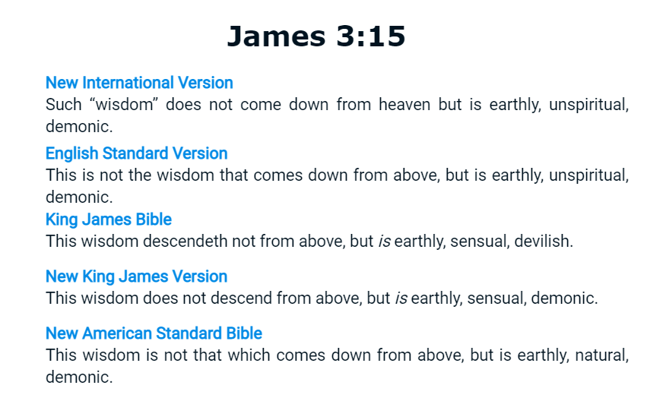

Slide 35
James 3
¹³ Who is wise and understanding among you? Let them show it by their good life, by deeds done in the humility that comes from wisdom. ¹⁴ But if you harbor bitter envy and selfish ambition in your hearts, do not boast about it or deny the truth. ¹⁵ Such “wisdom” does not come down from heaven but is earthly, unspiritual, demonic. ¹⁶ For where you have envy and selfish ambition, there you find disorder and every evil practice.
¹⁷ But the wisdom that comes from heaven is first of all pure; then peace-loving, considerate, submissive, full of mercy and good fruit, impartial and sincere. ¹⁸ Peacemakers who sow in peace reap a harvest of righteousness.

Slide 36
James 3
¹³ Who is wise and understanding among you? Let them show it by their good life, by deeds done in the humility that comes from wisdom. ¹⁴ But if you harbor bitter envy and selfish ambition in your hearts, do not boast about it or deny the truth. ¹⁵ Such “wisdom” does not come down from heaven but is earthly, unspiritual, demonic. ¹⁶ For where you have envy and selfish ambition, there you find disorder and every evil practice.
¹⁷ But the wisdom that comes from heaven is first of all pure; then peace-loving, considerate, submissive, full of mercy and good fruit, impartial and sincere. ¹⁸ Peacemakers who sow in peace reap a harvest of righteousness.

Slide 37
James 3
¹³ Who is wise and understanding among you? Let them show it by their good life, by deeds done in the humility that comes from wisdom. ¹⁴ But if you harbor bitter envy and selfish ambition in your hearts, do not boast about it or deny the truth. ¹⁵ Such “wisdom” does not come down from heaven but is earthly, unspiritual, demonic. ¹⁶ For where you have envy and selfish ambition, there you find disorder and every evil practice.
¹⁷ But the wisdom that comes from heaven is first of all pure; then peace-loving, considerate, submissive, full of mercy and good fruit, impartial and sincere. ¹⁸ Peacemakers who sow in peace reap a harvest of righteousness.

Slide 38
James 3
¹³ Who is wise and understanding among you? Let them show it by their good life, by deeds done in the humility that comes from wisdom. ¹⁴ But if you harbor bitter envy and selfish ambition in your hearts, do not boast about it or deny the truth. ¹⁵ Such “wisdom” does not come down from heaven but is earthly, unspiritual, demonic. ¹⁶ For where you have envy and selfish ambition, there you find disorder and every evil practice.
¹⁷ But the wisdom that comes from heaven is first of all pure; then peace-loving, considerate, submissive, full of mercy and good fruit, impartial and sincere. ¹⁸ Peacemakers who sow in peace reap a harvest of righteousness.

